Slide 1

Unity Audio

Slide 2
Learning Objectives
Understand the fundamentals of Unity's audio system.
Learn how to create and configure Audio Sources and Audio Listeners.
Master the use of Audio Clips and their various formats.
Utilize the Audio Mixer to control audio levels, apply effects, and create spatial audio.
Optimize audio performance for different platforms and devices.

Slide 3
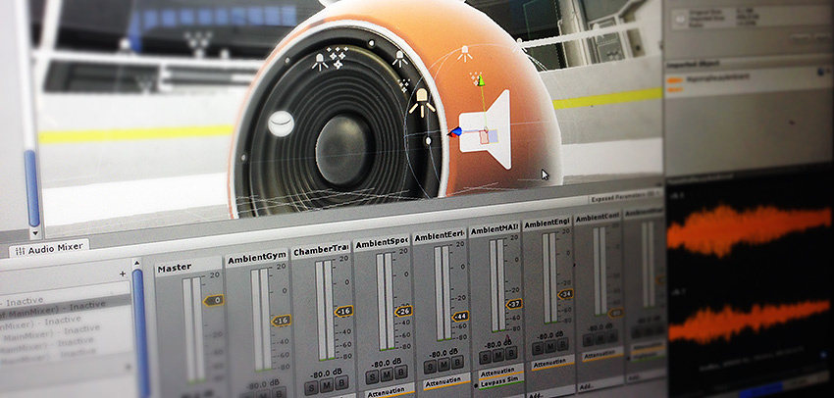
Introduction to Unity Audio
Real-time Audio: Unity provides a powerful audio engine for creating immersive sound experiences.

Slide 4
Introduction to Unity Audio
What is Unity Audio?
Unity's audio system allows you to create immersive sound experiences in your games. It provides tools for:
3D Spatial Audio: Simulating sound sources in 3D space.
Audio Effects: Applying effects like reverb, delay, and equalization.
Audio Mixing: Combining multiple audio sources and adjusting their levels.
Audio Recording: Capturing audio directly from your microphone.
References: https://docs.unity3d.com/2022.3/Documentation/Manual/Audio.html

Slide 5
Introduction to Unity Audio
Key Components:
Audio Source: Plays audio clips.
Audio Listener: Captures audio and applies spatialization effects.
Audio Mixer: Controls audio levels, routing, and effects.
Audio Clips: The actual sound files used in your game.
References: https://docs.unity3d.com/2022.3/Documentation/Manual/Audio.html

Slide 6
Introduction to Unity Audio
Key Components:
Audio Source: Plays audio clips.
Audio Listener: Captures audio and applies spatialization effects.
Audio Mixer: Controls audio levels, routing, and effects.
Audio Clips: The actual sound files used in your game.
References: https://docs.unity3d.com/2022.3/Documentation/Manual/Audio.html

Slide 7
Audio Clip
What is an Audio Clip?
Audio Clips are the fundamental building blocks for sound in Unity. They store the actual audio data that is played by Audio Sources. You can import audio files in various formats like WAV, MP3, OGG, and AIFF.
Key features of Audio Clips:
Audio Format: Determines the quality and file size of the audio.
Load Type: Controls how the audio is loaded into memory (on demand or preloaded).
Compression: Reduces file size but may impact audio quality.
Spatialization: Enables 3D audio effects like positional audio and Doppler effect.
References: https://docs.unity3d.com/2022.3/Documentation/Manual/class-AudioClip.html

Slide 8
Introduction to Unity Audio
Inspector Options:
Force To Mono & Normalize: Convert multi-channel audio to mono and adjust volume for consistency
Load In Background: Load audio without affecting main thread performance
Ambisonic: Special format for 360° and XR experiences
Inspector Options:
Play, loop, and preview selected audio clip (requires Unity Audio enabled in Project Settings)

Slide 9
Audio Clip
Properties:
Load Type: Defines how audio is loaded (decompress on load, compressed in memory, streaming)
Compression Format: Determines audio quality and file size (PCM, ADPCM, Vorbis/MP3)
Sample Rate: Sampling frequency of the audio (higher = better quality, larger file size)
Load In Background & Preload Audio Data: Control when audio loads (during scene load or on demand)
Quality: Adjust compression level for Vorbis/MP3 formats (higher = better quality, larger file size)
References: https://docs.unity3d.com/2022.3/Documentation/Manual/class-AudioClip.html

Slide 10
Audio Clip
Tips:
Use compressed audio for long files (music, dialog)
Use PCM/ADPCM for short, noisy sound effects
Balance compression with acceptable sound quality
Consider platform-specific audio format support
Remember: Choosing the right Audio Clip settings is crucial for optimizing your game's sound quality and performance!
References: https://docs.unity3d.com/2022.3/Documentation/Manual/class-AudioClip.html

Slide 11
Audio Source
What is an Audio Source?
An Audio Source is a component in Unity that plays back sound effects and music within your game. It acts like a controller for an audio clip, allowing you to:
Play, pause, and stop the sound.
Adjust volume, pitch, and stereo panning.
Create realistic 3D audio effects.
References: https://docs.unity3d.com/2022.3/Documentation/Manual/class-AudioSource.html

Slide 12
Audio Source
Key Properties:
Audio Clip: This is the actual sound file the Audio Source will play.
Play On Awake: If enabled, the sound starts playing automatically when the scene loads.
Loop: Makes the sound clip repeat continuously.
Volume: Controls how loud the sound is at a specific distance.
Pitch: Adjusts the speed of the playback, affecting the sound's "highness" or "lowness.”
Spatial Blend: Controls how 3D the sound feels. 0 is purely 2D, while 1 is fully 3D, taking into account distance and direction from the listener.
References: https://docs.unity3d.com/2022.3/Documentation/Manual/class-AudioSource.html

Slide 13
Audio Source
Key Properties (cont.):
3D Sound Settings: These properties further enhance the 3D audio experience, including:
Doppler Level: Simulates the pitch shift heard as a sound source moves closer or further away (Doppler effect).
Spread: Controls how wide the sound appears to be in 3D space.
Min/Max Distance: Defines the range where the sound is audible and how it fades with distance.
References: https://docs.unity3d.com/2022.3/Documentation/Manual/class-AudioSource.html

Slide 14
Audio Listener
What is an Audio Listener?
The Audio Listener is a crucial component in Unity's audio system. It acts as a virtual microphone, capturing and processing sounds emitted by Audio Sources in your scene.
Key Functions:
3D Spatialization: Enables realistic 3D sound effects, including positional audio and Doppler effect.
Reverb and Effects: Applies global effects like reverb and echo to all audio sources.
Audio Mixing: Manages the overall audio mix, including volume levels and panning.
References: https://docs.unity3d.com/2022.3/Documentation/Manual/class-AudioClip.html

Slide 15
Audio Listener
Best Practices:
Attach to Main Camera: Typically, the Audio Listener is attached to the main camera to ensure consistent audio positioning.
Consider Single Listener: Each scene should have only one Audio Listener to avoid unexpected behavior.
Optimize Audio Settings: Adjust settings like sample rate and bitrate to balance quality and performance.
Use Reverb Zones: Create specific areas in your scene with unique acoustic properties.
Experiment with Audio Effects: Add depth and realism to your game's sound design.
References: https://docs.unity3d.com/2022.3/Documentation/Manual/class-AudioClip.html

Slide 16
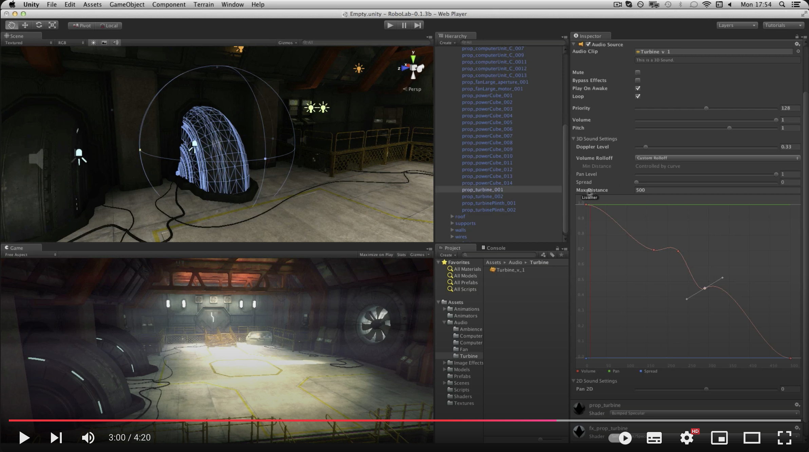
Working with Audio Sources & Listeners
Audio Sources & Listeners - Unity Official Tutorials:
References: https://www.youtube.com/watch?v=1BMJFgK68IU

Slide 17
Audio Mixer
What is an Audio Mixer?
The Audio Mixer is a powerful tool in Unity that allows you to control and manipulate audio in your game. It provides a flexible and efficient way to manage sound effects, music, and voiceovers.
Key Features:
Hierarchical Structure: Create complex audio systems with multiple mixers and submixers.
Audio Effects: Apply a wide range of effects like reverb, delay, EQ, and compression.
Snapshots: Save and recall specific mixer states for dynamic sound design.
Volume Control: Adjust the overall volume of audio groups.
Panning: Control the stereo panning of audio sources.
References: https://docs.unity3d.com/2022.3/Documentation/Manual/class-AudioMixer.html

Slide 18
Audio Mixer
How to Use the Audio Mixer:
Create an Audio Mixer: Create a new Audio Mixer asset in your project.
Assign Audio Sources: Connect Audio Sources to the Audio Mixer by setting their Output property.
Create Mixer Groups: Organize audio sources into groups for easier management.
Add Audio Effects: Insert effects like reverb, delay, and EQ into the mixer groups.
Adjust Mixer Parameters: Control volume, panning, and other parameters using the mixer's UI.
References: https://docs.unity3d.com/2022.3/Documentation/Manual/class-AudioMixer.html

Slide 19
Audio Mixer
Example:
Create a mixer group for background music.
Add a Reverb effect to the group to create a more immersive atmosphere.
Adjust the Reverb's decay time and pre-delay to fine-tune the effect.
Create another mixer group for sound effects.
Add a Low-Pass Filter to the group to reduce high-frequency noise.
References: https://docs.unity3d.com/2022.3/Documentation/Manual/class-AudioMixer.html

Slide 20
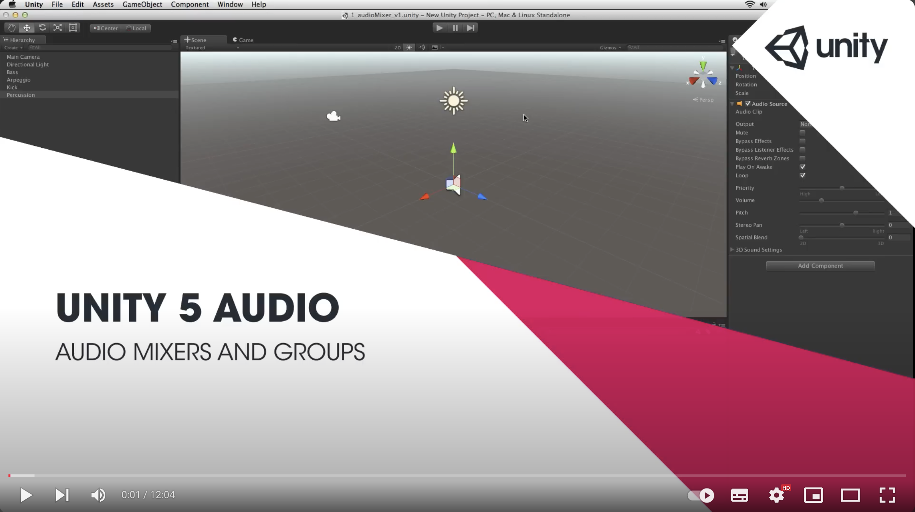
Audio Mixer
Audio Mixer and Audio Mixer Groups - Unity Official Tutorials
References: https://www.youtube.com/watch?v=vOaQp2x-io0

Slide 21
Recap
Unity's audio system provides a powerful set of tools for creating immersive sound experiences in your games. Key components include:
Audio Sources: Play audio clips and control their properties like volume, pitch, and spatialization.
Audio Listeners: Capture and process audio from Audio Sources, simulating 3D sound.
Audio Clips: Store audio data in various formats and control their loading and playback behavior.
Audio Mixers: Organize and process audio signals, applying effects like reverb, delay, and equalization.

